Slide 1

School Climate Improvement: A New Way Forward
A research-based, data-driven, school climate improvement program for
Franklin Township School
2017-2018
Community Introduction
Created by H. Timko, PE

Slide 2

What is school climate?
School climate refers to the quality and character of school life.
In a positive school climate:
Students feel socially, emotionally, and physically safe
All students and staff engage in positive relationships that demonstrate mutual respect
Students, families, and faculty work together to contribute to the school’s shared vision
Educators model and nurture how satisfaction is gained from learning.

Slide 3
Why are we talking about school climate now?

Slide 4

The issue at hand...
Recently collected school climate data has shown that:
Not all students have a positive attitude towards school.
_________________________________________
12 confirmed cases of Harassment, Intimidation, and Bullying during 2016-2017 school year.
Increase in minor behavior referrals

Slide 5
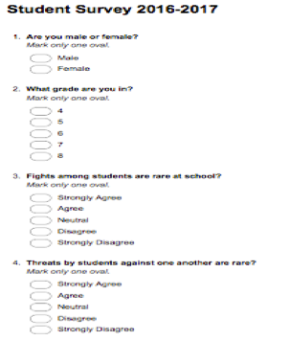
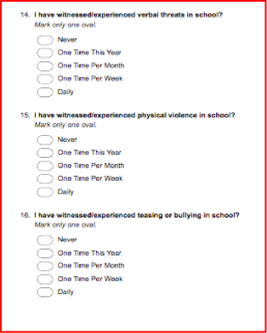
How do we know this? Student data.

Slide 6

How do we fix it?
Work together to:
Build long-lasting community relationships
Cultivate an environment where students feel safe, supported, and accepted
Positively impact student achievement for ALL students
Implement programs and procedures that support a positive school climate

Slide 7
What programs can help us produce a more positive school climate?

Slide 8


The “School Climate Improvement” program from the National Center on Safe Supportive Learning Environments
For more information go to: http://www.state.nj.us/education/students/safety/behavior/njscs/

Slide 9
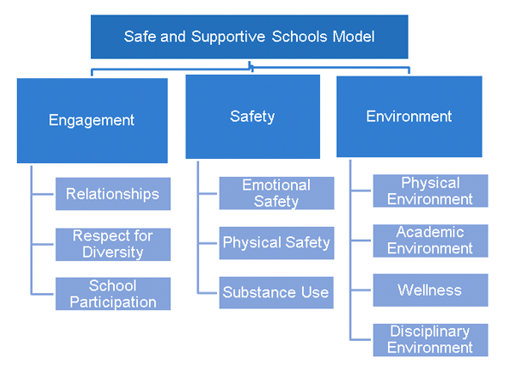
What is the “School Climate Improvement” program?
A 5 step process built on the tenets of:
Positive engagement
Promoting student safety
Producing a positive school environment

Slide 10
What are the five steps?
Steps for Success | What we need from you
Step 1: Planning for school climate improvements. | Assist in articulating vision, goals, objectives, and action steps
Step 2: Engaging Stakeholders in school climate improvements. | Sharing your feedback or concerns about initiatives
Step 3: Collecting and reporting school climate data. | Provide input on data collection and analysis strategies
Step 4: Choosing and implementing school climate interventions. | Review interventions
Step 5: Monitoring and evaluating school climate improvements. | Active participant in data evaluation procedures

Slide 11

What are the benefits of this program?
Uses student data to influence decision making
Engages all community members
Variety of supportive resources
Promotes student achievement

Slide 12

What are we trying to accomplish?
2017-2018 School Climate Objectives
Our goal is to achieve:
A decrease in teasing and bullying over the school’s new benchmark. Last year’s goal was not met.
A decrease in student discipline referrals, over last year. An increase occurred last year.
An increase in positive feelings of belonging and safety, over the new benchmark.
Benchmarks will be established from new survey data.

Slide 13

With your help we can create a more positive student learning environment!

